Slide 1
Hooke’s Law Lab Intro

Slide 2
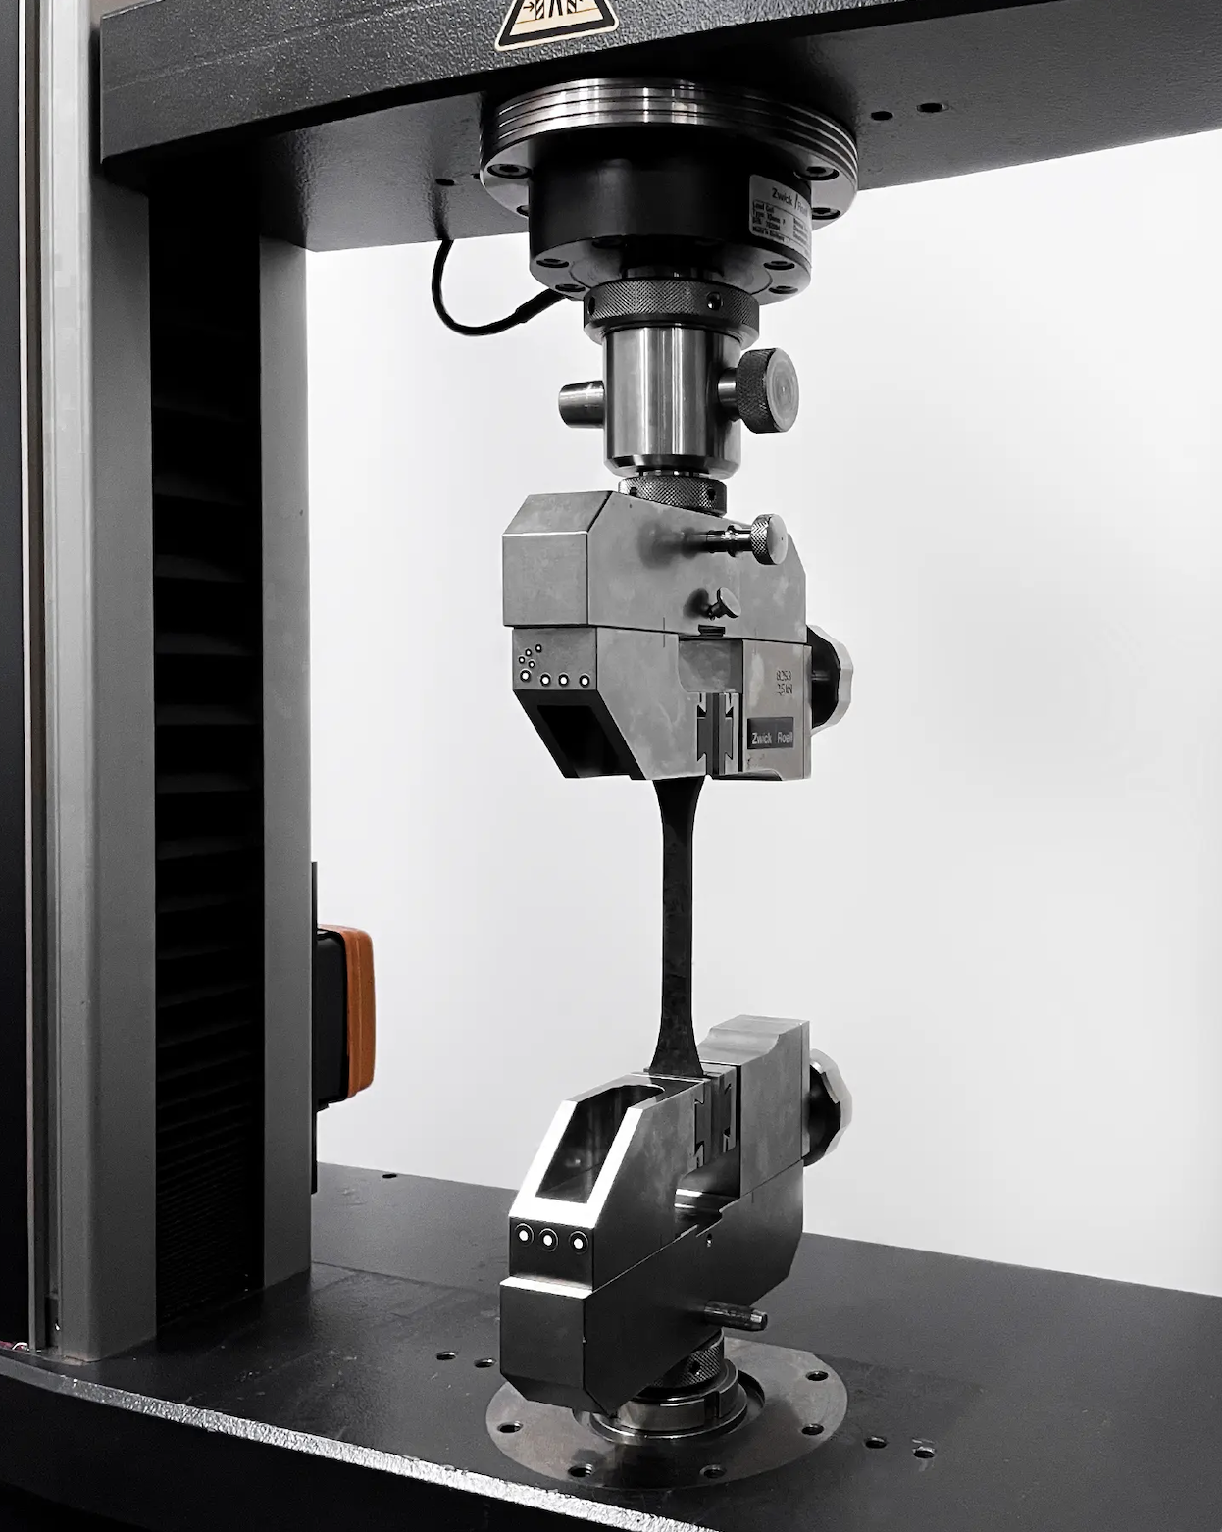

Hooke’s Law
$$F=−kx$$
the force F required to displace a material is linearly proportional to the resulting displacement x.
the constant of proportionality k quantifies the stiffness of the material
slope, k
Force [N]
elastic material
Displacement [m]

Slide 3
k isn’t always constant
Hooke’s Law isn’t perfectly accurate for all forces, for all materials
Many materials have “Hookean” (linearly elastic) and “non-Hookean” (not linearly elastic) regimes

Slide 4
Some materials stiffen when they’re deformed
cone-plate
rheometer
Force [N]
k is increasing
biological gel
Displacement [m]

Slide 5

Some materials weaken when they’re deformed
failure
k is decreasing
Force [N]
failure
Displacement [m]

Slide 6
Regime of Validity: A subset of the material’s behavior may be linearly elastic
Force [N]
Force [N]
Force [N]
Displacement [m]
Displacement [m]
Displacement [m]

Slide 7
Lab Goals
Explore the elastic behavior of a material of your choice
Search for linear and non-linear elastic regimes
Quantify k and its uncertainty precisely

Slide 8
Part 1 findings
Part 2 Experiment
Test a new material
Option 1
Linearly elastic
Test a different range of forces
Increase the precision of k
Test a new material
Option 2
Not linearly elastic
Test a different range of forces
Investigate a subset of forces more closely
Investigate the linear regime more closely
Option 3
Mixture
Investigate the nonlinear regime more closely
Examine the transition more closely

